Slide 1
Breast Cancer Risk Prediction System
Presented By
Mr. Talasila Vamsidhar,
Assistant Professor,
Koneru Lakshmaiah Education Foundation,

Slide 2

Selected Category
Under
Machine Learning

Slide 3
Purpose of Project
Breast cancer is one of the main causes of cancer death worldwide. Early diagnostics significantly increases the chances of correct treatment and survival, but this process is tedious and often leads to a disagreement between pathologists.
Computer-aided diagnosis systems showed potential for improving diagnostic accuracy. But early detection and prevention can significantly reduce the chances of death. It is important to detect breast cancer as early as possible.

Slide 4
Problem Statement
In the current era of Medical Care People has become more blunt for the doctors and with whatever disease they visit hospitals, most of them making fools of public and making un necessary test and finally gives a conclusion.
So, there is a need of model to predict the occurrence of Breast cancer disease.

Slide 5
Solution
By prediction of Breast cancer in healthcare we are able to take suitable measures accordingly to control the cancer tissue.
we propose a technique which consists of IBM Watson Studio with Auto AI Service. By using deep neural networks we are predicting whether the patient suffering with breast cancer or not.
Doctors have feasibility to test on a Node Red UI to know about the status.

Slide 6
Value Preposition
Easy to use Node Red UI as IBM Cloud Service
From past diagnosis data and health conditions doctors can easily predict the breast cancer.

Slide 7
Feasibility Study
A simple Node Red UI which uses ML model in backend which has an accuracy of 94% in prediction.
Financially feasible and so anyone can use it without the need of additional resources.

Slide 8
Data Collection- Kaggle Dataset
This dataset was downloaded from the Kaggle repository : https://www.kaggle.com/shivagayatrianandas/breast-cancer-detection
The dataset contains past data parameters of cancer patients.
The prediction is binary as it has either the person has a positive outcome of disease or not with respect to the images.

Slide 9
Data Preprocessing
Activity 1 : Taking care of the missing data
Activity 2 : Feature scaling
Activity 3: Visualization of the Data

Slide 10
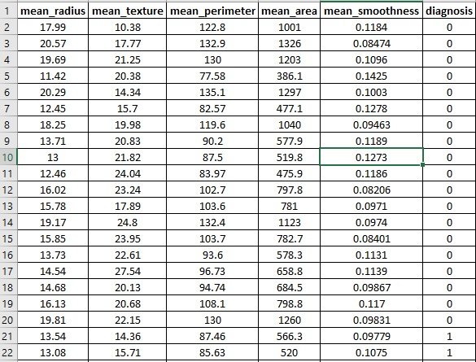
Final Dataset after Preprocessing

Slide 11
Training Accuracy (94.2%)

Slide 12
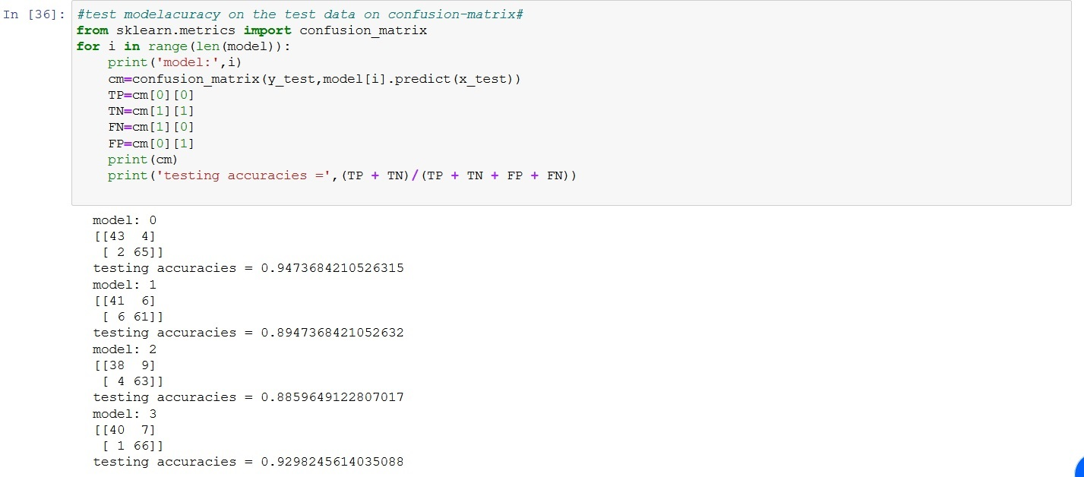
Testing Accuracy (94%)

Slide 13
Technology Stack
IBM Watson Studio for Auto ML Service
IBM Auto AI for predicting model
Node-RED for UI
Python for preparing python notebooks
Cloud object for storing dataset

Slide 14
Model Design
Deciding parameters or features
mean_radius, mean_texture,
mean_perimeter, mean_area, mean_smoothness
Separating Training and Testing data from the data set
Developing the model (XGB Classifier)

Slide 15
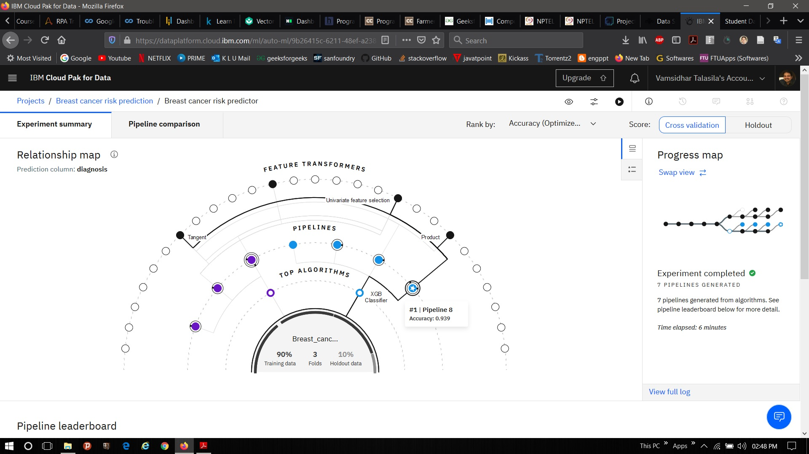
Watson Studio (Auto AI) Relationship Map

Slide 16
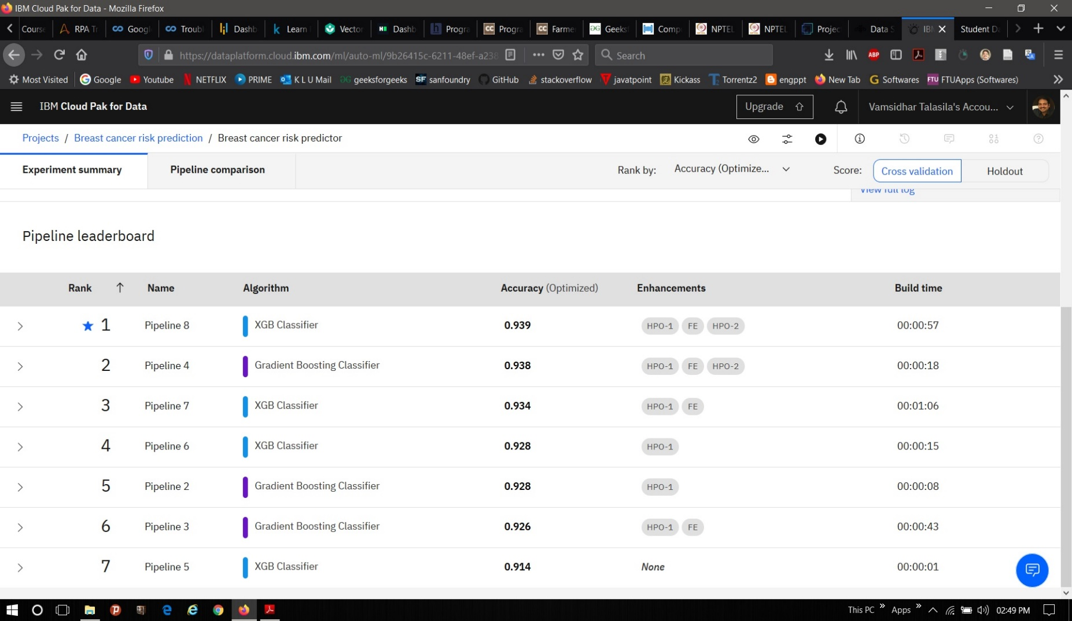
Watson Studio (Auto AI) Pipeline leaderboard

Slide 17
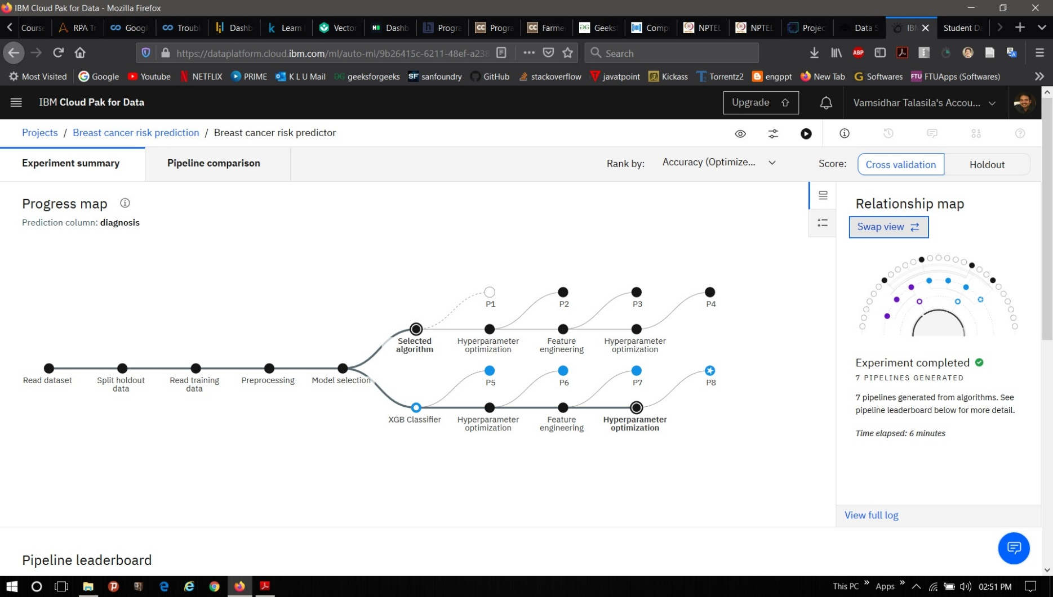
Watson Studio (Auto AI) Progress Map

Slide 18
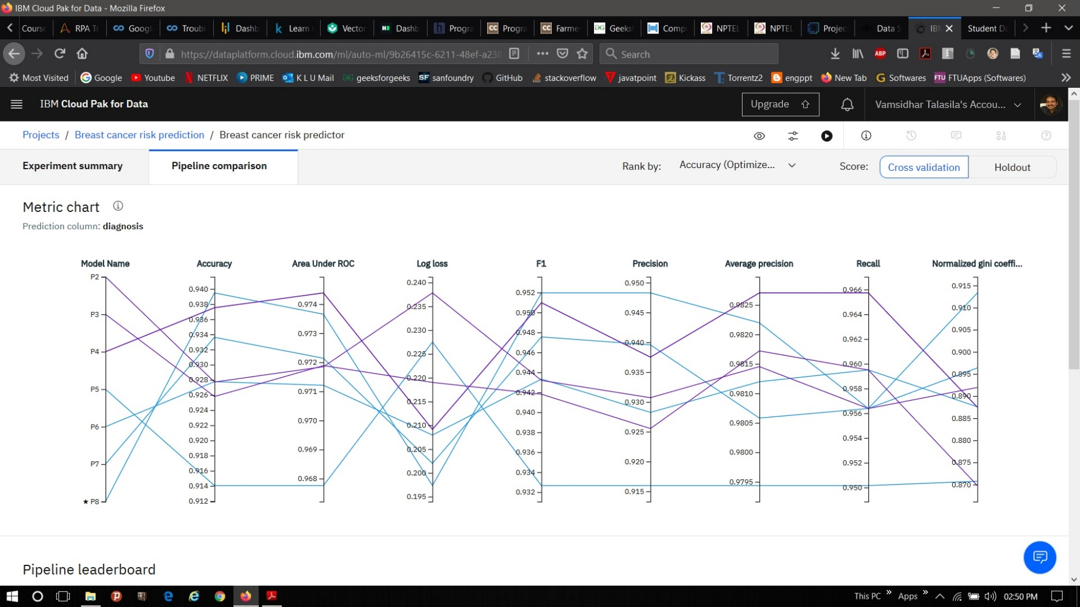
Watson Studio (Auto AI) Metric Chart

Slide 19
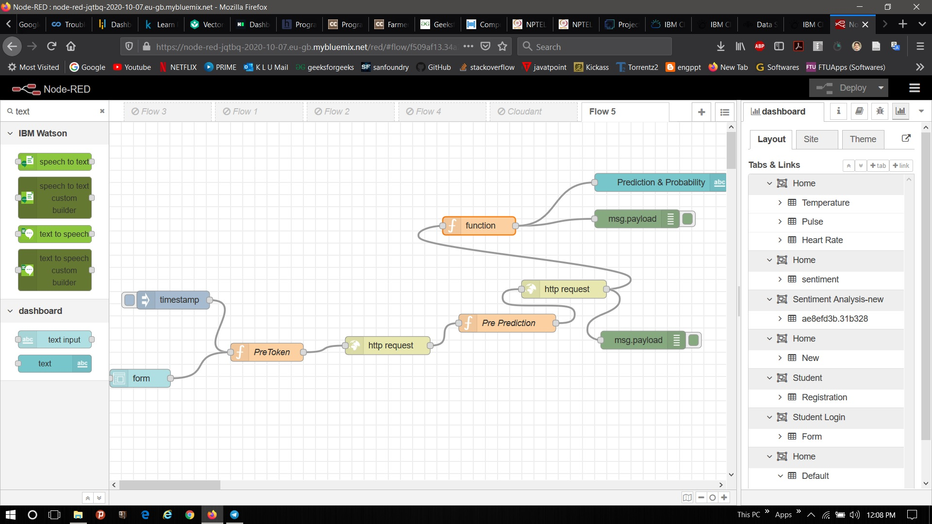
NodeRED UI Flow

Slide 20
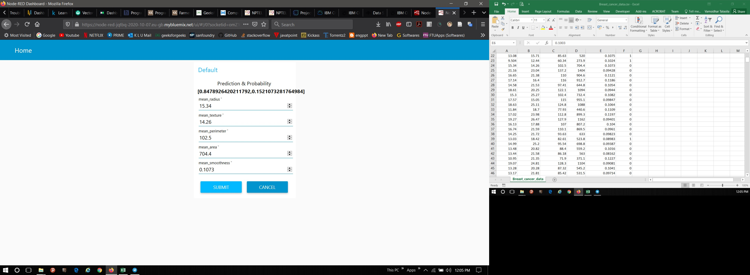
UI Output

Slide 21
Conclusion
In this project, I used IBM cloud services (subsidiary of IBM) to get accurate past breast cancer data. I analyzed several ML models, and chose XGB Classifier to develop this model.
This project gave us deep insight about the Node RED UI framework. I integrated the app with model and cloudant storage as Back-end.
The accuracy of XGB Classifier model for this project is 94%.

Slide 22


